Slide 1

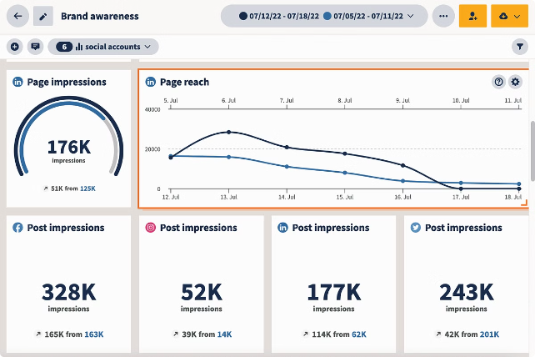

Introduction to Real-Time Analytics Dashboard
T.DIVYA CHANDRIKA
(192211908)
Unlock the power of your social media data with our cutting-edge real-time analytics dashboard. Gain unprecedented insights and make informed decisions to drive your platform's success.

Slide 2
Importance of Real-Time Data Monitoring for Social Media Platforms
Responsive Decision-Making
Proactive Issue Resolution
Competitive Edge
Stay ahead of the curve by quickly adapting to market changes and user preferences.
Make agile adjustments to your social strategy by monitoring real-time trends and user behaviors.
Identify and address platform issues quickly before they escalate, ensuring a seamless user experience.

Slide 3

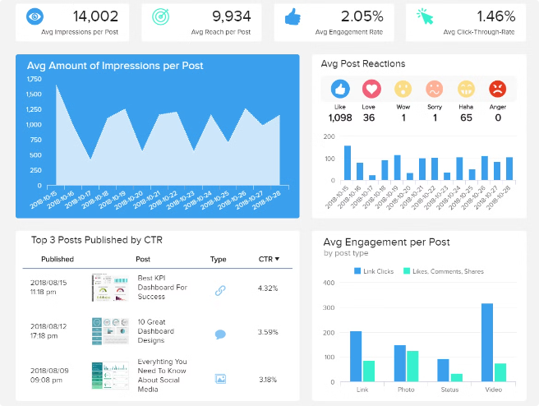
Key Metrics and KPIs to Track
1
Engagement Rate
Monitor likes, comments, shares, and other interactions to measure audience engagement.
2
Audience Growth
Analyze follower growth, new signups, and churn to understand user acquisition and retention.
3
Sentiment Analysis
Gauge the overall sentiment towards your brand and identify potential issues or opportunities.
4
Conversion Tracking
Measure the effectiveness of your social media campaigns in driving desired actions.

Slide 4

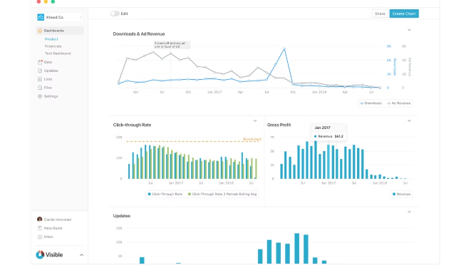
Data Sources and Integration
Social Media Platforms
Integrate data from leading social media platforms like Facebook, Twitter, Instagram, and TikTok.
Customer Data
Incorporate user profiles, interactions, and purchase data to gain a holistic view of your audience.
Marketing Campaigns
Sync data from your advertising and marketing campaigns to measure their social media impact.
Third-Party Tools
Leverage additional data sources like Google Analytics, CRMs, and survey tools for deeper insights.

Slide 5
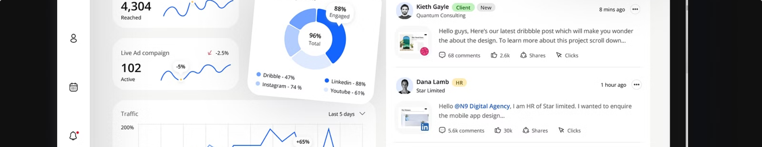




Dashboard Design and User Experience
Clean Interface
Customization
Mobile Responsiveness
Collaboration
A sleek, intuitive design that prioritizes data visualization and ease of use.
Tailor the dashboard to individual user preferences and access levels.
Share insights, create reports, and facilitate team collaboration within the platform.
Access critical insights anytime, anywhere with a mobile-optimized dashboard.

Slide 6

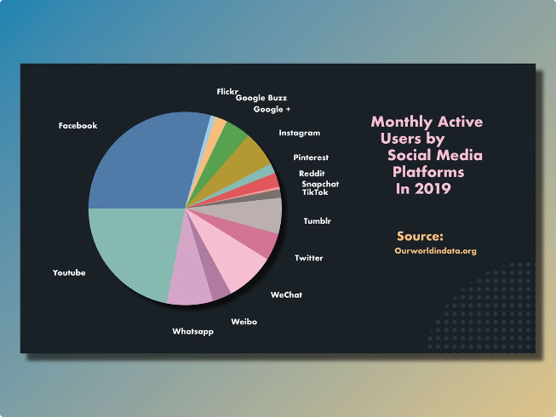
Real-Time Data Visualization Techniques
1
Interactive Charts
Dynamic charts, graphs, and visualizations that allow for deep data exploration.
2
Heatmaps and Trends
Identify patterns, anomalies, and emerging trends with intuitive heatmaps and trend analysis.
3
Geo-Spatial Mapping
Visualize location-based data to uncover geographic insights and audience distribution.

Slide 7


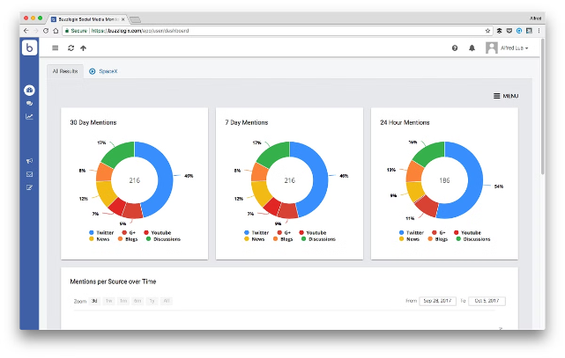


Alerts and Notifications
Real-Time Alerts
Get notified of critical events, such as sudden spikes in engagement or platform issues.
Customizable Thresholds
Set custom thresholds to trigger alerts based on your specific performance goals.
Proactive Notifications
Stay ahead of the curve with predictive alerts that anticipate potential problems or opportunities.

Slide 8

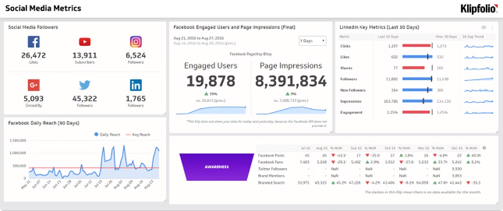
Conclusion and Next Steps
Unlock the Power of Data
Elevate your social media strategy with real-time insights
Streamline Decision-Making
Make informed, data-driven decisions to drive growth
Enhance User Experience
Deliver a seamless, personalized experience for your audience
Stay Ahead of the Curve
Quickly adapt to market changes and user preferences

